Slide 1

Covid-19: Domestic Energy Consumer Protection
Dave Newton - BEIS

Slide 2

Phase 1: Recognising the issue
31 Jan. 2020
first two cases of Covid-19 confirmed in UK
7 Mar.
over 200 cases recorded
11 Mar.
The budget includes £30bn to protect the economy from coronavirus
16 Mar.
PM advises against non-essential travel and contact
17 Mar.
Chancellor announces £330bn in loan guarantees for businesses
18 Mar.
government announces school closures
19 Mar.
Voluntary Energy Supplier Agreement
23 Mar.
PM announces lockdown

Slide 3
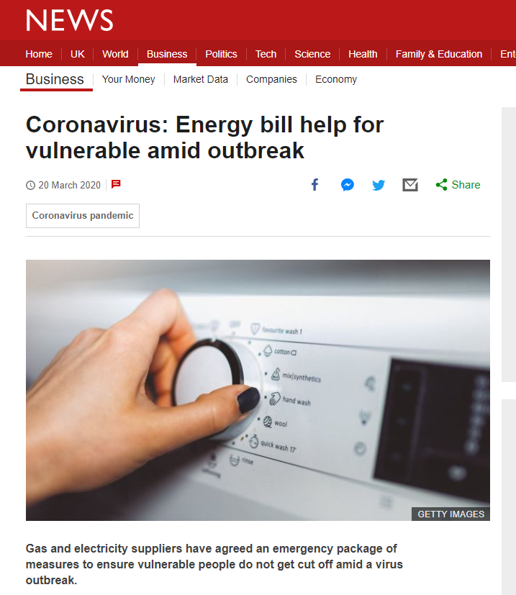
Phase 2: Delivering for consumers -
The Voluntary Agreement
Government developed principles to support consumers impacted by Covid 19
Worked with stakeholders to develop these into practical proposals
19th March - Energy supply companies agreed to:
  Identify and prioritise customers at risk
  support customers who are impacted financially
  support prepayment meter customers to stay on supply
  provide information to their customers

Slide 4
Phase 2 (cont.): Delivering for consumers -
Macro-economic support
  £330bn worth of loans and guarantees, tax deferrals
  Welfare measures worth over £6.5bn, including increases to Universal Credit, Working Tax Credits and Local Housing Allowances; and
  the Job Retentions Scheme and the Self-Employed Income Support Scheme (SEISS).

Slide 5

Phase 3: Monitoring and assessment
Stakeholder engagement
We work closely with Ofgem to share insights and analyse data, including Ofgem's RFI
We work with the statutory energy advice and advocacy body, Citizens Advice
We work with consumer and debt management organisations like StepChange, CitA and CAP
We work across Whitehall to develop cross sector approaches

Slide 6
Phase 3 (cont): Identifying customers most at risk
Those with lower income
Those with increased energy costs
Those in need of ‘emergency’ support to stay on supply
Those unable to top up their supply

Slide 7
Phase 4: Policy Development
  Current help available:
  Fuel Vouchers (WHD Industry initiatives and Ofgem redress schemes)
  Emergency and friendly credit from suppliers
  Payment holidays of debt repayments
  Winter 2020/1:
  Working to develop mitigation options to support those most at risk

Slide 8
Phase 4 cont: Data Sharing
Options:
1. Data sharing with suppliers to support customers
This is only possible in the context of policies specified in legislation: ECO, WHD and safeguarding tariffs
Developing a centralised data sharing scheme to support customers directly
2. We can also share data with third parties such as charities if they work for the Department to help alleviate fuel poverty under a direct contract
Such options could be used to identify customers as risk, e.g. through data on free school meals for those forced to home school during a further lockdown, shielding, UC and WHD data

Slide 9

Phase 5: Thinking ahead - longer term impacts
  Looking at cross-sector approaches to supporting consumers
  Monitoring and assessing consumer debt issues
  Assessing the impact of a potential second wave and policy options should this happen
  The 2020 Fuel Poverty Strategy for England will set out a holistic, longer term plan for supporting fuel poor households

Slide 10
We are listening
We are actively seeking information and feedback about the experience of consumers, charities and suppliers
Ministers are engaging and listening
We are keeping all options open

